Slide 1
CSE7302 - INTERNSHIP
Review-1 Presentation
CLIENT SUCCESS INTERN At Talent Recruit
Student Details
Name | Neha Ananya
Roll No | 20221CCS0078
Section | 8 CCS 01
Under the Supervision of,
Dr. Sharmasth Vali Y
Assistant Professor,
Presidency School of CSE
Presidency University
Name of the Program: B.Tech
Name of the HoD: Dr Anand Raj S P
Name of the Program Internship Coordinator: Ms Nisha Robin Rohit
Name of the School Internship Coordinator: Dr. Md Ziaur Rahman

Slide 2
Content
About Company or Organization
Working domain or the technology
About your team and reporting Manager
Challenges Faced in Internship
Objectives of the work
Internship Roadmap
Github Link

Slide 3
About Company or Organization
Talent Recruit is a smart recruitment and onboarding platform that helps companies hire faster and better.
It uses AI and Machine Learning to automate hiring tasks like job posting, candidate screening, interview scheduling, and onboarding—all in one place.
A key feature is ERIKA, a 24×7 robotic recruiter that handles candidate communication, follow-ups, and scheduling, reducing manual work and improving candidate experience.
With AI insights and analytics, Talent Recruit helps recruiters make faster, data-driven, and unbiased hiring decisions.

Slide 4
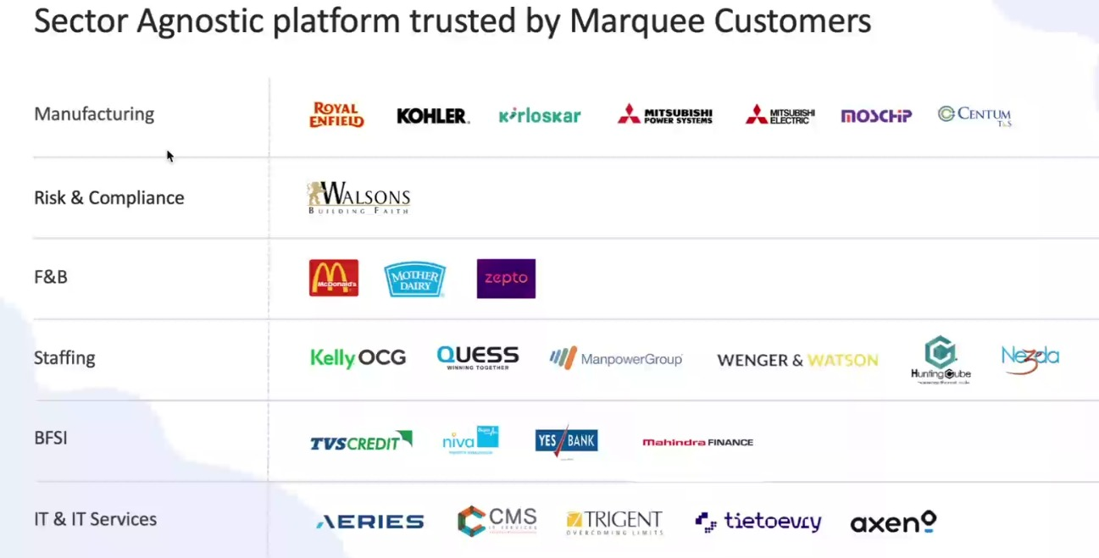
Our Clients

Slide 5
Working domain or the technology
Artificial Intelligence (AI) for intelligent recruitment automation
Machine Learning (ML) for resume screening and candidate ranking
Natural Language Processing (NLP) for chatbot and candidate interaction
Applicant Tracking System (ATS) architecture
SaaS (Software as a Service) cloud-based platform model
Database Management Systems for candidate and job data storage
REST APIs for integration with job portals and communication tools
Chatbot Technology (ERIKA – Robotic Recruiter)
Recruitment Analytics and Reporting Dashboards
Workflow Automation Systems

Slide 6
About your team and reporting Manager
Team Structure, Project & Technology Understanding
Our team has 9 members led by our Reporting Manager, Mr. Ashish Meridatta.
Currently, we are in the training phase learning the company’s ATS (Applicant Tracking System).
Technology Understanding:
AI & ML: Used for resume screening and ranking candidates
NLP: Helps chatbots communicate with candidates
ATS Workflow: Tracks candidates through hiring stages
Databases: Store candidate and job details
APIs: Connect job portals and communication tools
Dashboards & Analytics: Show recruitment performance insights
This training helps us understand how technology solves real recruitment problems.
After training, we will work on live projects for hands-on experience.

Slide 7
Challenges Faced in Internship
I was selected through my college campus placement process. Clearing the interview with the company’s CCO was a major challenge, as it involved in-depth technical questions, role-based scenarios, and problem-solving assessments. This experience tested my analytical thinking, technical knowledge, and ability to perform under pressure, helping me gain confidence and clarity about industry expectations.

Slide 8
Objectives of the work
Understand ATS system architecture and recruitment workflows
Support AI-based resume parsing and candidate shortlisting
Assist in database validation and candidate data management
Ensure smooth workflow automation across hiring stages
Support API integrations with job portals and communication tools
Analyze recruitment dashboards and system reports
Identify and resolve basic system-level issues
Improve system efficiency and data accuracy

Slide 9
Internship Road Map
Note: Write in the below table what u will be achieving in each review
Review 1
Product training and understanding the mechanisms
Review 2
Review 3
Review 4
Final Review

Slide 10
Github Link
https://github.com/NehaAnanya/Internship-Report

Slide 11
Q&A

Slide 12
Thank you !!

